Slide 1
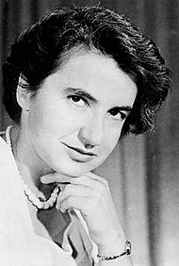
Guess the scientist
I was born in 1920 and died in 1958
I earned my PhD by calculating how coal performance could be predicted
I began to study X-Ray diffraction of different proteins, however DNA became more interesting
I discovered that there were two strands of DNA and that it was in a helical shape
Watson and Crick used my experimental results to publish their DNA model
They won the Nobel Prize in 1962 alongside my colleague Maurice Wilkins
I also pioneered the discovery of the shape of RNA using X-Rays
I died from various cancers as a result of radiation exposure

