Slide 1
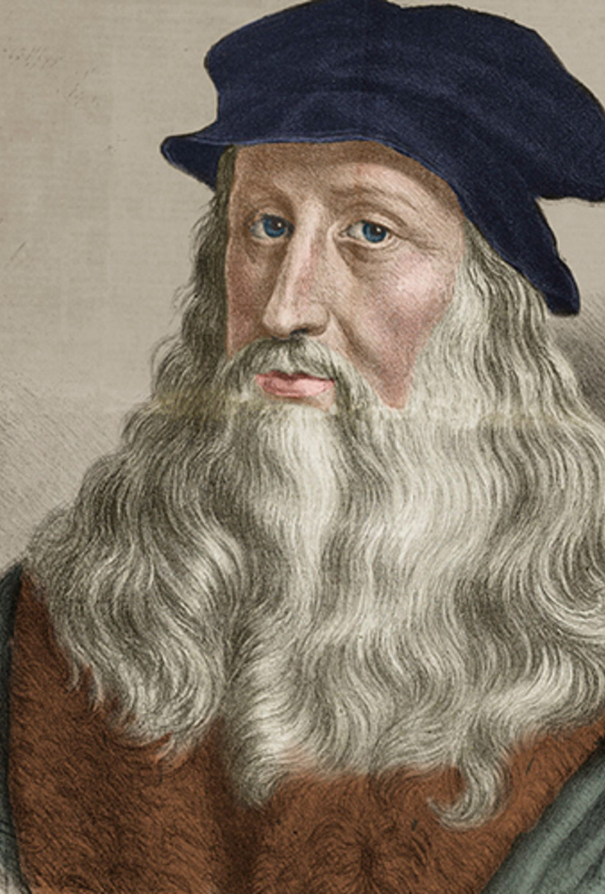
Guess the scientist
I was born in 1452
I am credited with the inventions of parachutes, tanks and helicopters, as a result of my sketches and designs for them
I conceptualised flying machines, armoured vehicles and focusing the use of solar power
I dissected animals to learn about their anatomy
I wrote many of my best ideas in mirror image cursive, to avoid plagiarism
I completed a few paintings

