Slide 1

Subject Choice for Leaving Certificate

Slide 2
Introduction
The Leaving Certificate (Established) is a two-year programme that aims to provide students with a broad, balanced education while also offering some specialisation towards a particular career option.
7 subjects taken
Notes:
The programme is taken in almost all schools and by an annual cohort of around 55,000 students. Students following the Leaving Certificate (Established) programme are required to study at least five subjects, one of which must be Irish. In general, students take five or more subjects (usually seven) for examination. Here in Ardgillan all students will be required to take 7 subjects and the best 6 results will be used for the purpose of points. All subjects are offered at two levels, ordinary and higher. Irish and Mathematics are available at foundation level also.

Slide 3
Entry to college courses is points based
A students best 6 subjects are used to calculate their LC points

Slide 4
NOTE: There are 25 bonus points for students who achieve greater than 40% in Higher Maths
New Points System for Leaving Certificate 2017 onwards
Higher Grade | Points |  | Ordinary Grade | Points
H1 90-100% | 100 |  | O1 90-100% | 56
H2 80<90% | 88 |  | O2 80<90% | 46
H3 70<80% | 77 |  | O3 70<80% | 37
H4 60<70% | 66 |  | O4 60<70% | 28
H5 50<60% | 56 |  | O5 50<60% | 20
H6 40<50% | 46 |  | O6 40<50% | 12
H7 30<40% | 37 |  | O7 30<40% | 0
H8 0<30% | 0 |  | O8 0<30% | 0

Slide 5
Further Education Options
Option | Qualification | NFQ Level
University (DCU) | Hons Degree | 8
Institute Technology (DkIT) | Hons Degree Ord Degree | 8 7
Further College of Education (DIFHE) | QQI Qualification Post Leaving Cert. | 6 (2 years) 5 (1 year)

Slide 6
CAO 2019 some observations:
Demand /Supply points requirements are increasing in areas where there is strong jobs growth, such as the computer science, engineering and technological sectors.
Fewer adults and further education graduates are currently seeking college places through the CAO. They seem to be choosing employment over education.

Slide 7
Nursing is generally in high demand, though many courses saw a drop in points, especially in areas such as general and intellectual disability nursing and midwifery.
Primary teaching, also, saw some small surprise drops in points for courses. However, early childhood education was up across the board
Psychology has been hugely popular this year. It is up 21 to 509 in DCU, up 22 to 565 in Trinity, up 16 to 517 in UCD, and up 22 to 495 in Maynooth.

Slide 8
The subject choices you make have the ability to either severely limit or expand your options when it comes to college
Notes:
There are however a few other factors to take into account and this relates to question 3 (What do you need)
Your final choices should balance your interests with the requirements of the colleges and universities
In terms of college entry, you’ll need the points for your course, but you’ll also need to meet the matriculation requirements of the particular college and perhaps specific requirments of individual courses.

Slide 9
Things to consider
Matriculation requirements
Specific Course Requirements
Leaving Certificate Points

Slide 10

Matriculation Requirements

Slide 11
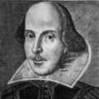



NUI Requirements
(University College Cork, University College Dublin, NUI Galway & Maynooth University.)
Irish
English
Maths*
A Third Language*
Notes:
NUI
•UCC
•UCD
•NUIG
•NUI MAYNOOTH
* Some exceptions to the rule in NUI faculties – we will look at this in more detail when we do a unit on college requirements. This is simply to give you a general overview and to highlight the relevance of core subjects and our school policy on taking a third language.

Slide 12
Non NUI Requirements
English
Maths
Irish / Third Language
Notes:
NON-NUI
•UL
•TRINITY
•DCU
•IT’s

Slide 13
Subject Choices
Core subjects (all students must take)
English
Irish
Maths
3rd Language

Slide 14

Choosing your additional subjects

Slide 15


Languages | Science | Humanities | Business | Technology
French Spanish | Biology Physics Chemistry Computer Science | Art Home Ec Music History Geography Religion Politics & Society | Business Economics Accounting | Construction DCG Technology Engineering
Notes:
It is the policy of Ardgillan to recommend to all students to choose a modern language (the languauge studied for JC) . Students can then choose an additional 3 subjects from the list above.
It is preferred that students would choose a subject which they studied for JC, however in the case of a student wanting to do a subject for LC that was not studied at JC the final decision will be at the discretion of the subject teacher and will be based on the students ability to pick up after missing the 3 year Junior course.

Slide 16
Information on all of these subjects can be found in the subject choice booklet.
Students should carefully read about each subject – don’t make presumptions!
Talk to subject teachers
Talk to career guidance teacher

Slide 17
Remember when choosing subjects...
What do you like?
What are you good at?
What do you NEED?
Notes:
Here are 3 key questions that each individual student should spend time reflecting on. There are a lot of influencing factors in this decision – parents, teachers, outside factors such as the economy and jobs market but ultimatley the decision lies with the individual students and these 3 questions should help in taking the 1st step toward knowing yourself and your future prospects a bit better.

Slide 18
Courses that need a science subject
SCIENCE
ENGINEERING*
MEDICINE*
DENTISTRY*
VETERINARY*
PHARMACY*
PHYSIOTHERAPY
RADIOGRAPHY
NURSING
NAVAL CADETS
ARCHITECTURE
OCCUP. THERAPY
SPEECH THERAPY
SPORTS SCIENCE
MED LAB SCIENCE
DIETETICS
OPTOMETRY
PRODUCTION MGT.
INDUSTRIAL DESIGN
INFO. TECH.
Notes:
Some need a specific science subject .. Some need 2 science subjects

Slide 19
Specific Requirements of Courses
Where to go for Information?
www.careersportal.ie
www.qualifax.ie
Notes:
As well as Matriculation requirements some courses have individual specifications for entry:
For Example:
Honours Engineering Degrees require Honours Mathematics.
An Honour in Honours Irish is required for Primary Teaching.
Science Subjects are required for science degrees and medical courses.
The Qualifax website is one which all students should sign up to (i.e. They can create their own account). It provides information on further and higher education and training courses. This service aims to help students make informed choices about their education, training and career paths. We can use this website to research the specific requirments of individual courses using the path as follows – click on link and then:students – useful tools, minimum subject requirments, LC subjects)
I will now give a demonstration of how to use Qualifax in this way.

Slide 20
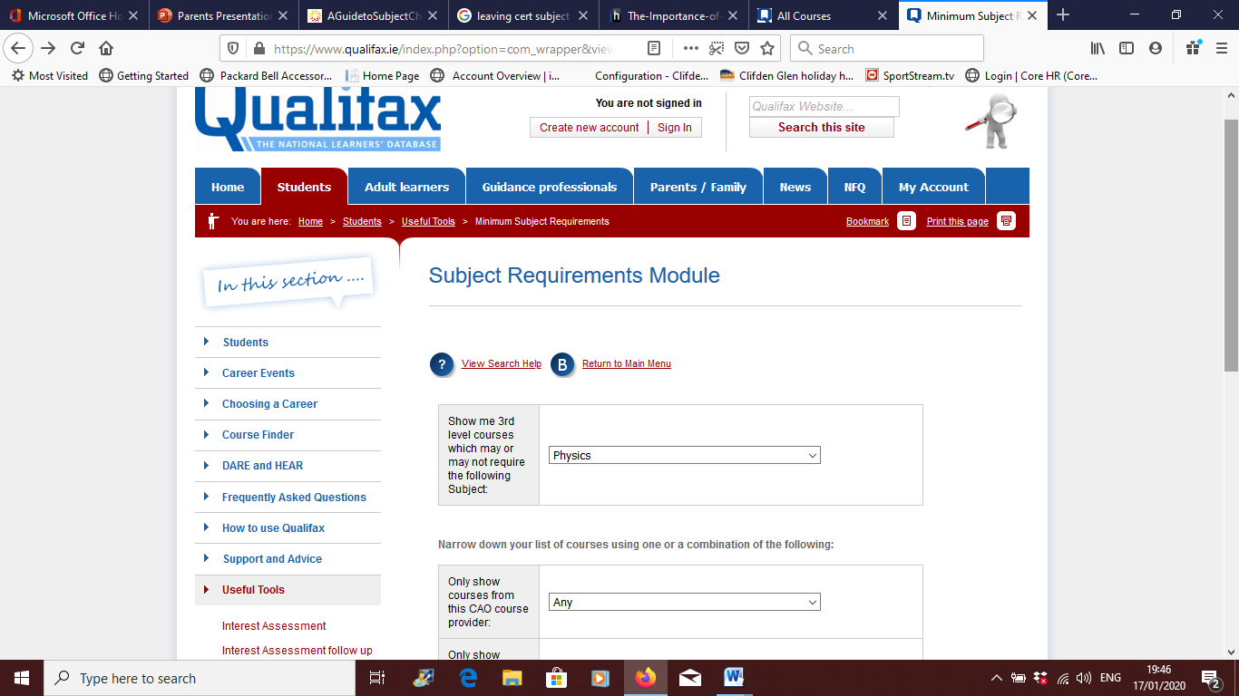

Slide 21
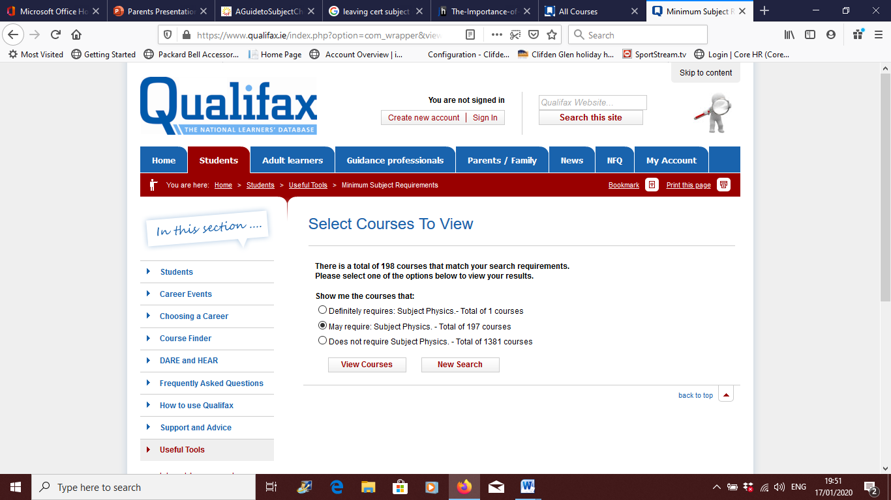

Slide 22
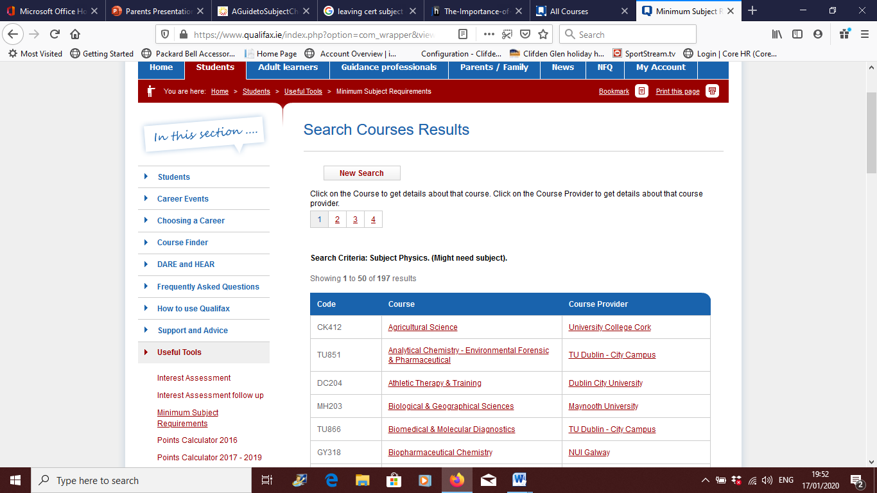

Slide 23
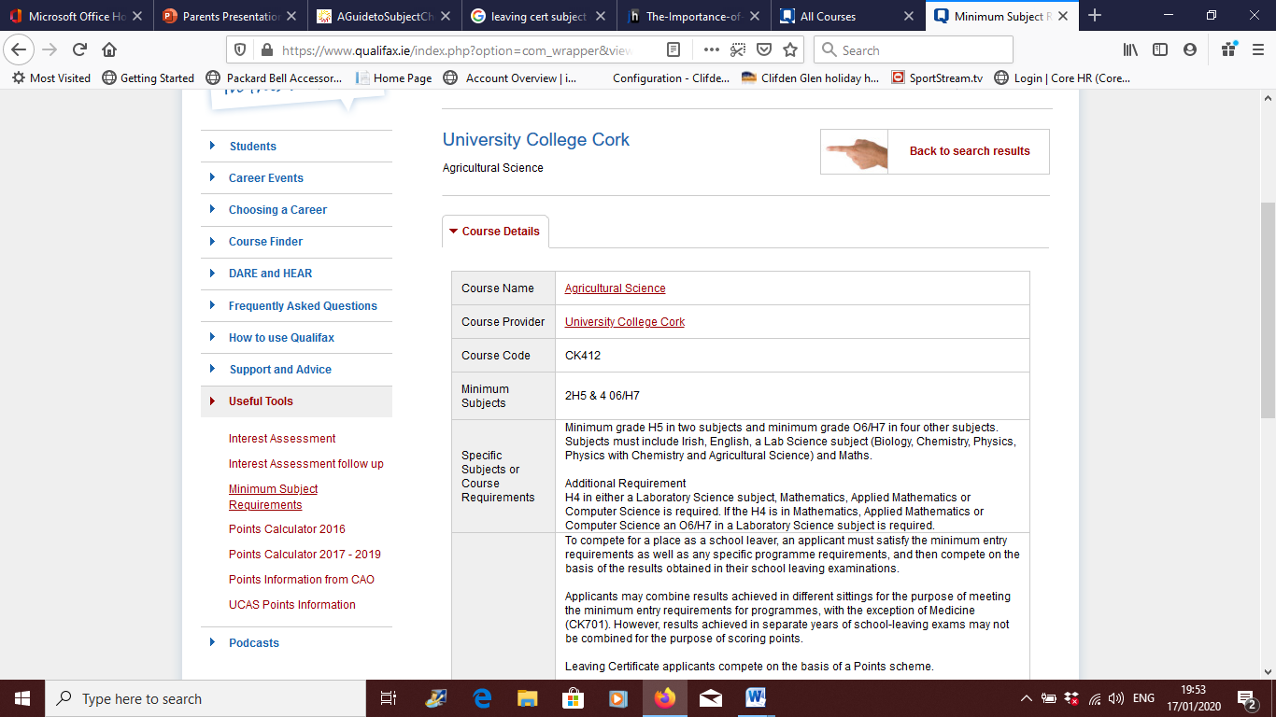

Slide 24
NOTE!
Ultimately we want each of our students to do the best leaving certificate they can possibly do.
Therefore as a general rule we don’t encourage students to take on a subject they have not studied at JC.
If you are considering this please speak to a teacher of that subject.
Look at your JC results and consider what are the subjects that can potentially get you the most points.,
Be careful of subject combinations e.g two science subjects

Slide 25
Keeping all Options Open
English
Irish
Maths
A Third Language
A Science Subject
2 additional Subjects
Notes:
While websites like qualifax are an essential tool in students deciding their career path it is also important for us to remember that very few young people of 15 or 16 years of age are sure of what they want to do after school, and may change their minds about possible future careers several times before they complete their Leaving Cert – so really at this stage it is all about keeping your options open!!
I would encourage students to revisit the 3 key questions we looked at earlier in the presentation, to reflect on what subjects they like, what they think they will be good at in Leaving Cert and also what they think they may need in terms of third level courses. What is needed to assess each of those areas is an insight into Matriculation and Courses requirments but also and essentially to know what each subject has to offer.
For all Students here in Ardgillan they will be required to take at least one Science subject and their language from JC, as well as the 3 core subjects of English, Irish and Maths. That leaves students with 2 remaining subjects to choose from.
So what do those subjects have to offer? And which are right for you?

Slide 26
Key points!
What does the student like and what is the student good at? (To maximise your points!)
What is essential for a possible career? Do I need science?
Is there a balance between Arts, Sciences, Business?
What may be desirable for a possible career?

Slide 27
What happens next?
Students have received a Subject Choice Form.
Students must list their choices in order of preference.
Hand back to Ms Delaney by 24th February

Slide 28
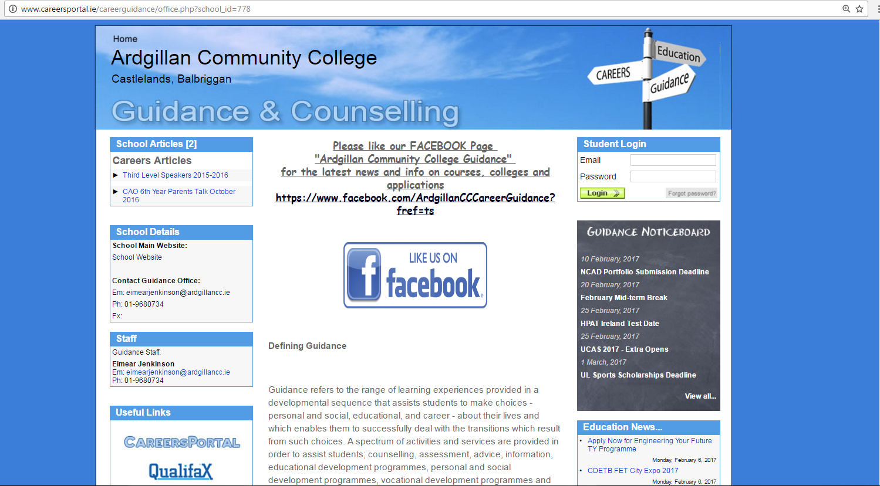
Career Guidance page on school website

Slide 29
Some useful websites
www.careersportal.ie
www.cao.ie
www.ucas.ac.uk
www.eunicas.ie
www.qualifax.ie
Notes:
To find out more on what each of these subjects have to offer or to research courses and requirments please refer to some of the following websites.

